Slide 1
SSTC31269: Business Requirements Modelling
Week 1 Seminar – Introduction to Business Requirements Modelling
What is Business Requirements Modelling?
Role of a Business Analyst (BA)

Slide 2
31269 Business Requirements Modelling
Subject Outline:
Refer the PDF document on UTS online. Read it thoroughly to understand what is involved in this subject and how is it going to be assessed.

Slide 3
Objectives
Understand what is involved in the subject Business Requirements Modelling (BRM)
Understand the role of a Business Analyst (BA)

Slide 4
Scenario 1
You have been working as a developer in a software development organization for a number of years.
You have been recently given the role of a Business Analyst.
Your main responsibility is to work with the business and IT stakeholders to identify and model the requirements and then communicate to developers for development.
You are required to work as an advisor and mediator between the business and IT.
You do not have any experience in the new role... What would you do?

Slide 5
Scenario 2
So you want to be an IT business analyst…..
UTS would like to offer BScIT course online. They need to upgrade their existing system or develop new system to support the online course.
You are assigned as a business analyst to this project
You need to capture and model requirements or changes for the existing/new system to support online course delivery
You need to provide estimates for the requirements task
You need to provide estimates for the whole project development.
What would you do………………………………….?

Slide 6
Subject Learning Objectives (SLOs)
Upon successful completion of this subject students should be able to:
Identify stakeholders, understand their needs, and learn what/how to capture requirements in the system development process.
Apply modelling and systems analysis techniques that help understand the working of a business system.
Document and specify various requirements via Software Requirements Specification (SRS).
Develop various models using a range of systems analysis techniques to analyse and specify system and user requirements.
Work effectively in a small team.

Slide 7
Who are Stakeholders?
Stakeholders
An individual, team or organisation who have interest in, or participate in the development of requirements and relative software system
Stakeholders have different roles based on their interest and responsibility in an organisation
Project Manager, Business Analyst, Sponsor, End User, Owner, Subject Matter Expert, etc.
Failure to discover all stakeholders can mean failure to discover all their needs.
More details on Stakeholders in next week’s Seminar.
Notes:
Failure to discover all stakeholders can mean failure to discover all their needs. Find all parties who will be affected by the product, and find their requirements/needs.
For more details see BABOK Guide Chapter1.
More details about this topic in Week2 Seminar (next week).

Slide 8
What are Requirements?
A requirement is:
a condition or capability needed by a stakeholder to solve a business problem or achieve an objective (BABOK v2.0).
A requirement is a usable representation of a need. Requirements focus on understanding what kind of value could be delivered if a requirement is fulfilled. The nature of the representation may be a document (or set of documents), but can vary widely depending on the circumstances (BABOK v3.0). Or
a statement of need that must be met by a particular product or service to solve a business problem or achieve an objective (Robertson & Robertson 2012)

Slide 9
Requirements Examples
Examples
a customer must be able to place an order for a book on the phone in less than 5 minutes between 9:00 AM and 5:00 PM (Monday to Friday).
Or/And
a customer must be able to place an order for a book via a 24/7 online system in less than 3 minutes
Requirement = People + Process + Data + Software System + Quality + Assumption + …

Slide 10
Why Requirements?
Requirements are needed for:
developing a new or altering an existing business process, service or product e.g., order management process
developing a new or altering an existing software system e.g., online order processing system

Slide 11
What is Modelling?
Model
is a representation of a real world entity or object or subject of interest (TOGAF 9.1). Examples of models are a business process model, data model, software system model, etc.
AS IS (Current State) and TO BE (Future State) Models

Slide 12
What is Business Requirements Modelling?
Business Requirements Modelling:
Involves understanding the client’s business problems and needs (requirements), and developing a set of diagrams known as requirements models, each of which focuses on a different aspect of the users' needs (business needs). e.g.
People or Stakeholders (Modelling)
Process (Modelling)
Data (Modelling)
Object Oriented Modelling
Recall:
Requirement = People + Process + Data + Software System + Quality + Assumption + …

Slide 13
Business Requirements Models – Stakeholders Modelling
Example: People or Stakeholders List/Map/Register
Source: https://www.youtube.com/watch?v=BkUCcJwwvAQ&t=373s
More details in next Seminar
Source: https://www.youtube.com/watch?v=BkUCcJwwvAQ&t=373s
More details in next Seminar
Name | Position | Project Role | Contact Information | Level of Interest | Level of Influence | Potential Management Strategies
Mike Sundby | VP of HR | Project Champion | msundy@globalconstruction.com | High | High | Mike is very outgoing and visionary. Great traits for a project champion. He is concerned about financials and has an MBA. Keep him informed and ask for his advice as needed.
Lucy Camerena | Training Director | Project Sponsor | lcamerena@globalconstruction.com | High | High | Lucy has a PhD in Education and knows training at this company. She is very professional and easy to work with, but she can stretch out conversations. Make sure she reviews important work before showing it to other managers.
Ron Ryan | Senior HR staff member | Led the Phase I project | rryan@globalconstruction.com | Medium | Medium | Ron led the phase I project and is upset that he was not asked to lead this phase II project. He's been with the company for over 20 years and can be a good resource but he can also sabotage the project. Ask Lucy to talk to him to avoid problems. Perhaps give him a small consulting role on the project.
Xxx Yyyy
Yyy Zzz

Slide 14
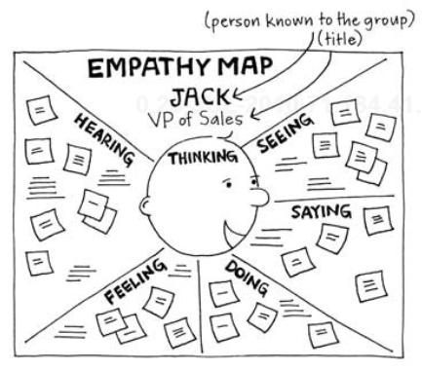
Business Requirements Models – Stakeholders Modelling
Example: Empathy Map
Source: http://www.cooper.com/journal/2014/05/persona-empathy-mapping
More details in next Seminar

Slide 15
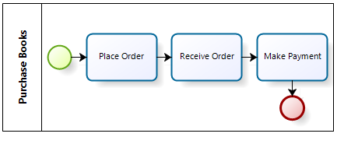
Business Requirements Models – Process Modelling
Process (Modelling): is the analytical representation or illustration of an organization’s business processes.
It is used to map out an organization’s current (or “as-is”) processes to create a baseline for process improvements and to design future (or “to-be”) processes
Example (Business Process Model)
More details in Week 4 Seminar

Slide 16
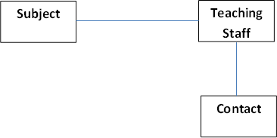
Business Requirements Models – Data Modelling
Data models model people, things, places and concepts about whom data is required.
Data model identifies the entities or objects that the organisation will need to hold data about
Example (Entity Relationship Diagram ERD)
More details in Week 5 Seminar

Slide 17
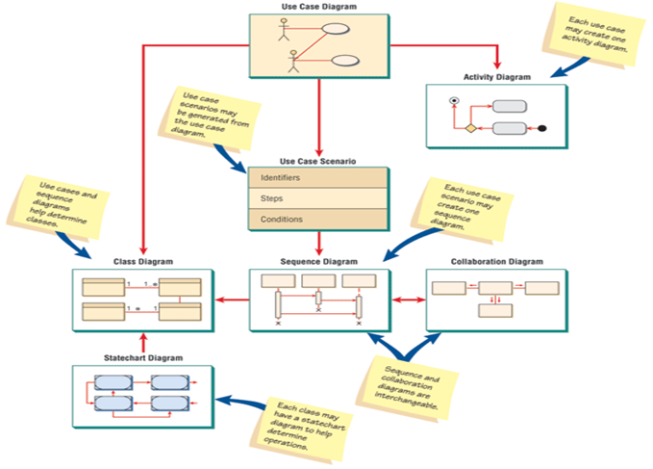
Business Requirements Models – Object Oriented Modelling
Object Oriented Models (OO models) using Unified Modelling Language (UML)
Examples of OO models are:
Use Case Diagram
Class Diagram
Sequence Diagram
State and Event Diagrams, etc
More details in Weeks 8 to 11 Seminars

Slide 18
What is Business Analysis?
Business analysis is the practice of enabling change in an enterprise by defining its needs and rationale for change, and then design, describe and recommend solutions that deliver value to its stakeholders.
Business Analysis can be used to understand the current state, to define the future state, and to determine the activities required to move from the current to the future state.
Source: BABOK Guide, Section 1.2

Slide 19
Role of a Business Analyst (BA)
Tasks/Activities
Business/domain knowledge: Understand what does the business do
Understand problems and needs of business (requirements)
Manage stakeholders and communication with them
Modelling: Develop and communicate business requirements models
Review business requirements with stakeholders
Obtain Sign Off
Recommend software solutions, alternatives and cost estimates
Engage in Software testing
Do not ask “what are your requirements…?”

Slide 20
Business Analyst (BA) Skills/Competencies
BA Skills
Analytical Thinking and Problem Solving Skills
Behavioural Characteristics/Skills
Business Knowledge
Communication Skills
Interaction Skills
Tools and Technology
For more details, see section 9 of BABOK Guide.

Slide 21
BA Skills
Analytical Thinking and Problem Solving Skills
Creative thinking
Decision making
Learning
Problem solving
Systems thinking
Conceptual thinking
Visual thinking
For more details, see section 9 of BABOK Guide.

Slide 22
BA Skills
Business Knowledge
Business acumen
Industry knowledge
Organisation knowledge
Solution knowledge
Methodology knowledge
For more details, see section 9 of BABOK Guide.

Slide 23
BA Skills
Behavioural Skills
Ethics
Accountability
Trustworthiness
Organisation and time management
Adaptability
For more details, see section 9 of BABOK Guide.

Slide 24
BA Skills
Communication Skills
Verbal Communication
Non-Verbal Communication
Written Communication
Listening
For more details, see section 9 of BABOK Guide.

Slide 25
BA Skills
Interaction Skills
Facilitation
Leadership and Influencing
Teamwork
Negotiation and Conflict Resolution
Teaching
For more details, see section 9 of BABOK Guide.

Slide 26
BA Skills
Tools and Technology
Office Productivity Tools and Technology
Business Analysis Tools and Technology
Communication Tools and Technology
For more details, see section 9 of BABOK Guide.

Slide 27
Techniques used by a BA
Techniques:
Interviews
Surveys/Questionnaires
Requirements Workshops
Observation
Prototyping
Modelling:
Stakeholders Modelling
Process Modelling via BPMN 2.0
Data Modelling via ERD and Data Dictionary
Object Oriented Modelling
Use Case Diagram, Class Diagram, Sequence Diagram, State Transition Diagram, etc
Watch “Intro to Business Analysis” Video uploaded on UTS Online https://www.youtube.com/watch?v=XsKdzHVEXig

